Slide 1
Word Study Overview
Eastern Elementary
RTI Team

Slide 2
Topics of Discussion
Purpose of Word Study
Levels of Learning
Stages of Word Study
Qualitative Spelling Assessment
Three Tiers of Orthography
Principles of Word Study Instruction

Slide 3
Common Spelling Practices
Memorizing a weekly list of grade level spelling words
Letting children choose the words they wish to study
Targeting spelling errors for spelling list words

Slide 4
Word Study
Conceptual! Categorical!
Begins with assessment
Spelling features are chosen according to developmental sequence
Connected to reading and writing
Direct Instruction…with gradual release of responsibility to student control

Slide 5
A Conceptual Approach
Allows children to compare and contrast specific features.
Categorization facilitate a deeper understanding of spelling principles.
Example: FLAT VS. BRAKE
Example: PILOT VS. FOLLOW
EXAMPLE: EDUCATION VS. REVISION

Slide 6
The Ultimate Goal of Word Study
To teach children how to compare and contrast word features so that they can conceptualize the predictable patterns of English spelling.

Slide 7
Purpose of Word Study
Provide connection between learning to read and spell
Provide developmental approach to spelling instruction where students work on instructional level
Allow students to compare and Contrast categories of word features through hands-on opportunities

Slide 8
Purpose of Word Study
Provide a link between word study and text
Provide systematic scope and sequence of word-level skills
Increase students specific knowledge of words (spelling and meaning)
Reveal consistencies in our written language system

Slide 9
Layers of English Orthography
Sound
(Letter Name Stage)
Pattern
(Within Word Pattern Stage)
Meaning
(Syllables & Affixes; Derivational Relations)
SEP/sip
LITE/light
COMPUSITION/ composition

Slide 10
Evolution of Modern English
Sound: Anglo-Saxon influence; Old English; Sound matching to record dialects
Pattern: Norman Conquest; French influence; Middle English; more regular spellings
Meaning: Renaissance; Latin and Greek influence; Great vowel shift

Slide 11
The Historical Development of Spelling
Anglo-Saxon
WIF (wife)
TODAEG (today)
HEAFONUM (heaven)
(Lord’s Prayer, 1000)
Norman French
YONGE (young)
SWETE (sweet)
ROOTE (root)
CROPPE (crops)
(Chaucer, 1440)
Renaissance
DISSCORD (discord)
FOLOWE (follow)
MUSSIKE (music)
(Elizabeth I, 1600)
Letter Name
WIF (wife)
TODAE (today)
HAFAN (heaven)
(Tawanda, age 6)
Within Word
YUNGE (young)
SWETE (sweet)
ROOTE (root)
CROPPE (crops)
(Antoine, age 8
Syllables & Meaning
DISSCORD (discord)
FOLOWE (follow)
MUSSIC (music)
(Julian, age 14)

Slide 12
Synchrony of Literacy Development
Reading
Writing
Spelling

Slide 13
Synchrony of Literacy Development
Emergent
Letter Name
Within Word Pattern
Syllables and Affixes
Derivational Relations
Emergent
Beginning
Transitional
Intermediate
Advanced

Slide 14
Stages of Word Study
Emergent
Letter Name Alphabetic
Within Word Pattern
Syllables & Affixes
Derivational Relations

Slide 15
Emergent Stage
Shows interest in reading and writing
Recognizes common names
Uses Invented writing
Has difficulty showing beginning and ending of words
Uses random marks and known letters

Slide 16
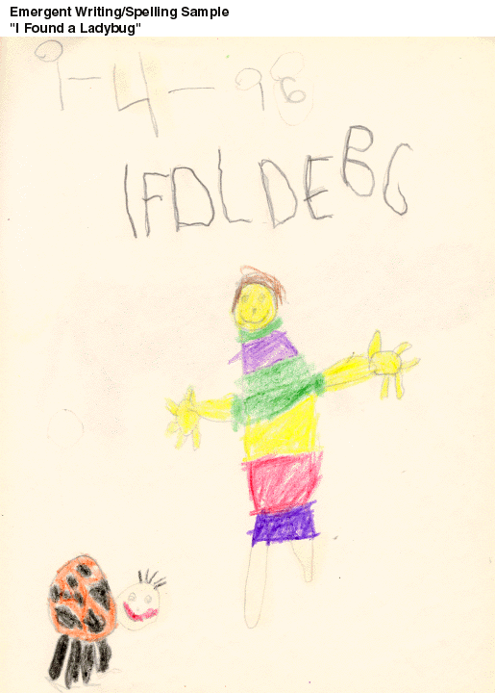
Emergent Sample

Slide 17
Letter Name Stage
Considered beginning readers
Reading is choppy and disfluent
Uses predictable text, pictures, and consonant knowledge to read
Uses short simple sentences with spaces between words
Spells with beginning and ending consonants, eventually leading to CVC

Slide 18
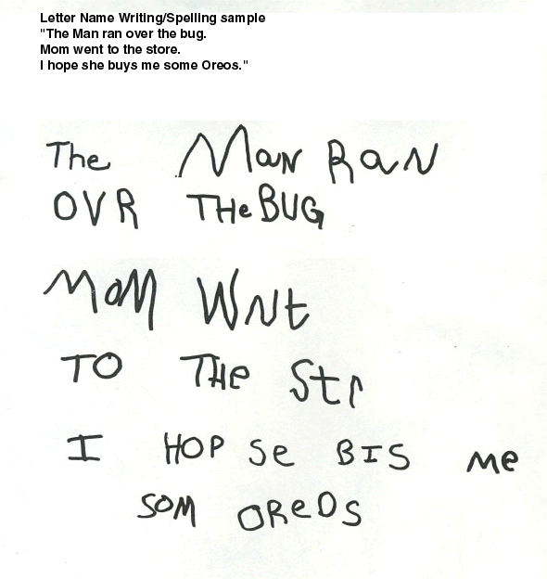
Letter Name Sample

Slide 19
Within Word Stage
Considered transitional readers
Reads with more fluency and expression
Uses beginning, middle, and end in writing
Spells CVC words correctly
Works on long vowel patterns, r-controlled vowels, and vowel diphthongs
Studies sound and patterns

Slide 20
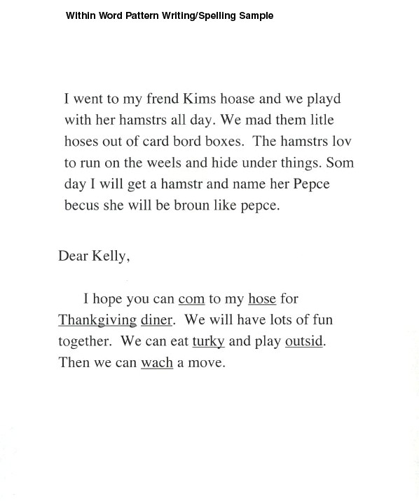
Within Word Sample

Slide 21
Syllables & Affixes Stage
Considered intermediate readers
Reads fluently and for pleasure
Uses more sophisticated Vocabulary
Writes a variety of genres
Spells one-syllable words
Works on multi-syllable words, open and closed syllables, simple prefixes and suffixes

Slide 22
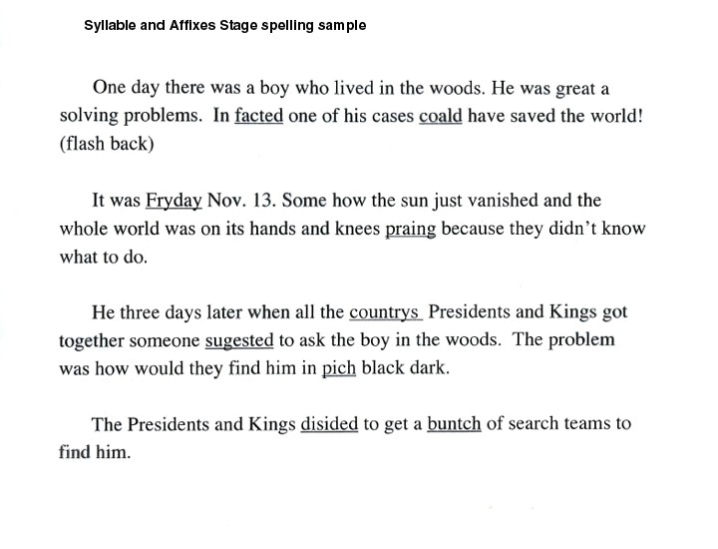
Syllables & Affixes Sample

Slide 23
Derivational Relations
Considered advanced readers
Reads in areas of interest
Writes for variety of audiences and purposes; personal reflection included
Uses spelling and vocabulary knowledge to connect unknown words
Works on difficult prefixes and suffixes, schwa, Greek and Latin roots

Slide 24
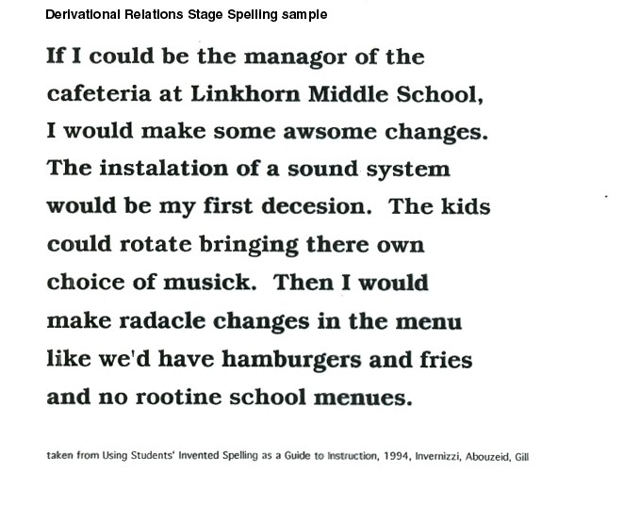
Derivational Relations Sample

Slide 25
Qualitative Spelling Assessment
Students are assessed using PALS beginning, middle, and end of the year
Students are grouped according to results
Assessment results determine instructional fit and guides instruction

